Slide 1

Implementing Daily Data Driven
Instruction
Presenters: Dr. Mayreather Willis & Dr. Kristin Forrester
Notes:
Prior to beginning have all teachers print out the “Doing What Works” work book @ http://ies.ed.gov/ncee/wwc/publications/practiceguides/?PGID=12 and down load the file Using student Achievement Data to Support Instructional Decision Making
View the Abbott and Costello video “Who’s on First”, the laughter should help relieve anxiety about using data and identify with staff about the confusion that comes with implementing data driven instruction
Slide 18 is when the teachers will complete activities within this book.
Print Slide 4 and, Hand out for slide 8 titled DoingWhatWorks Data Drive Instruction
Print out Hand Outs titled- Hand –Outs from AdvancEd 3 & 4 and Quick Formative Assessment

Slide 2
Daily Data Driven Instruction
Segment 1
Now that I have data, what’s next?: Looking at data and standards
Segment 2
Planning to Implement Daily Data Driven Instruction
Segment 3
The good, the bad & the ugly:
Evaluating Implementation of Daily Data Driven Instruction

Slide 3

Goals:
To build a common process to support usage of curriculum, instruction, and assessment to drive daily instructional decisions.
Objectives:
to have a common daily data driven process
to have a common vision of how to plan, implement, and evaluate daily data driven instruction.
to have common language and processes for collecting and
analyzing data, setting goals, planning, implementing, and
evaluating daily data driven instruction.
At the end of this workshop we will respond to goals and objectives.

Slide 4
Essential Questions:
Why is it important to use daily data driven instruction?
How do you support the implementation of daily data driven instruction?
How does data driven school culture effect change in student achievement?
How does implementing daily data driven instruction affect the teaching and learning process?
At the end of this workshop we will respond to each EQ.

Slide 5
What do you know about DI and using data to
drive daily instruction?
  K
What do you want to know about DI and using data to drive daily instruction?
  W
What did you learn about using DI and data to drive daily instruction?
  L
Please describe your experiences, knowledge, and expertise. Before, during, and after the presentation please continue to fill in the KWL to include any questions you have during the presentation that we will discuss at the conclusion.
Notes:
Print this page as an hand out.
Before beginning presentation have teachers complete it and review how it will be used during the presentation.

Slide 6
Segment 1: Now that I have data, what’s next?:
Looking at data and standards
Agenda
1st Introduction to Daily Data Driven Instruction
by Doing What Works - Video
2nd Cycle of Improvement – the process
Discussion
3rd Looking at data and standards
To find out what students don’t know and need to know
Activity
Now that I have data …
Plan instruction to address students’ deficits
Have a test talk with students - Activity
Before We Meet Again

Slide 7


Notes:
Share the wording of about what “Doing what Works” is about and can provide

Slide 8

Using Student Achievement Data
to Support Instructional Decision Making
Notes:
Click the start and begin the video

Slide 9
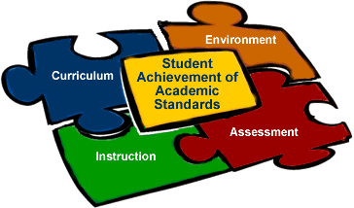

Building
Background
Why use data to drive daily instruction?
Collecting and analyzing data, setting goals, planning, implementing, and evaluating begins with the realization that none of these components are independent of each other.
-AdvancEd
Curriculum, instruction and assessment are the important elements for obtaining high student achievement.
-DoDEA Standards

Slide 10


Cycle of Improvement
Make data part of an ongoing cycle of instructional improvement.
To help all students achieve, teachers need to systematically and routinely use data to guide instructional decisions and meet students' learning needs.
Data use is an ongoing cycle of
collecting multiple data sources
interpreting data to formulate hypotheses about strategies to raise student achievement
implementing instructional changes to test hypotheses
Source: http://dww.ed.gov
Notes:
Share with teachers the five steps in the process (each process will link to a video, just click start), the 2nd pic links to a document:
Cycle of Improvement
Students Us of Data
Vision for Data Use
Data-Driven Culture
Distinctive Data Systems
2. After each review of the video, have teachers refer to the KWL to determine similarities and differences in about what they know.
3. Then have teachers write down what they learned and would like to know (the “would like to know” will be used as the ticket out the door to determine what process needs to be further developed.

Slide 11
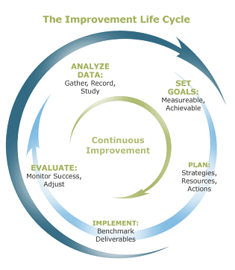
Teacher -
completes this task, and then test talk with students
Teacher & Student-
How much will you improve?
An example, from 75 to 80, or 75 to 85 in one grading period or a semester
Teacher & Student
“The data is only as good as the teacher who uses it. You have to factor in dedication, caring, and skills.”
-Doris Piekarski
Teacher – plan instruction that is based one data, using multiple teaching strategies
Student – review your data, how will you improve beyond teacher facilitated instruction?
Teacher and Student–
Assess, assess, assess
Dynamic and Screening
from curriculum
Source of cycle: AdvancEd.com
Hand
Out

Slide 12
Dynamic Assessment
“Curriculum-based approaches that use actual content from the learner's educational program, with interventions based on "best practices" of teaching.”
Source: www.dynamicassessment.com
Dynamic assessments are embedded in ongoing instruction in the classroom. Teachers assess individual students according to their instructional goals during teaching and learning interactions. Teachers conduct the assessments frequently and keep a systematic record of how individual children perform. They use this information to tailor and shape instruction to the needs of children in the class, as well as to measure their progress against instructional goals [Strands, standards, and components].
Source: Department of Education @ www.ed.gov
Outcomes & Objectives
Assessment focuses on the learner's processes … that promote as well as obstruct successful learning.
Assessment provides information about what instructional interventions are successful and promote change in the learner.
Assessment is most often administered in a pretest-progress monitoring-posttest format.
Assessment is most useful when used for individual diagnosis and for screening of classroom size groups.
Most unique information from the assessment is information about the learner.
The underlying assumption of dynamic assessment is that all learners are capable of some degree of learning.
DoDEA Standards

Slide 13
Screening Assessment
Screening assessments are given to all children at the beginning of the class or school year. The purpose is to identify children who may have difficulties in a subject area. These difficulties need to be addressed if they are going to succeed. Screening tests are short and involve questions that probe for the presence of basic skills and abilities.
Source: Department of Education @ www.ed.gov
Outcomes & Objectives
A method of collecting data for determining how each student is performing in a given area.
Screening reveals the low and high performing students.
Screening is an initial step in instructional decision-making and is necessary to identify needs early.
Screening assessment activities provide data to help determine if there are systemic needs in the core cycle: curriculum, instruction, environment, and/or within the overall system itself.
Source: Iowa CORE Curriculum

Slide 14
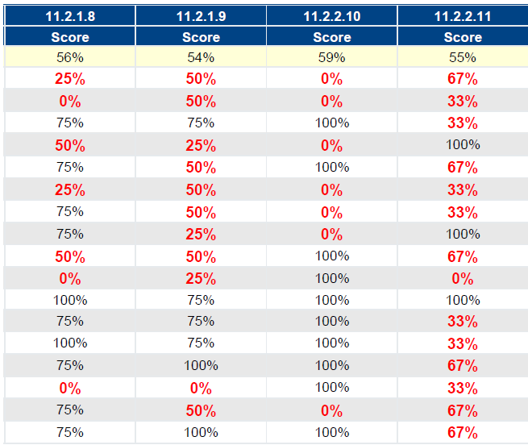
Vertical
Small
Group
Horizontal
Whole Group

Slide 15
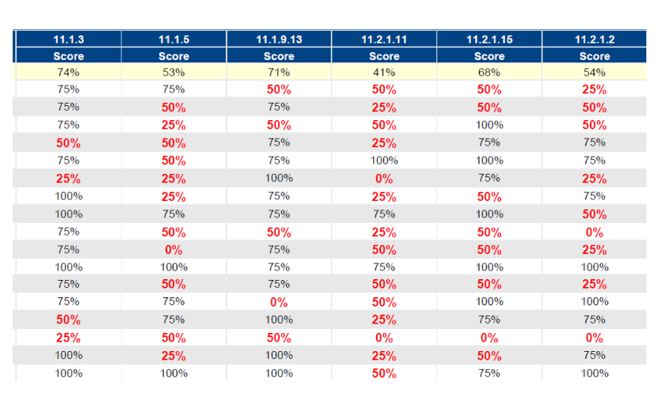
Analyze this Data
Compare the standards
Notes:
Teachers should analyze for
Whole and small group instruction
Most frequently missed
Class Averages
Individual Students

Slide 16

Hands On Activity
Test-talk with your students, so that they can become actively engaged in the process
Notes:
Make copies of

Slide 17
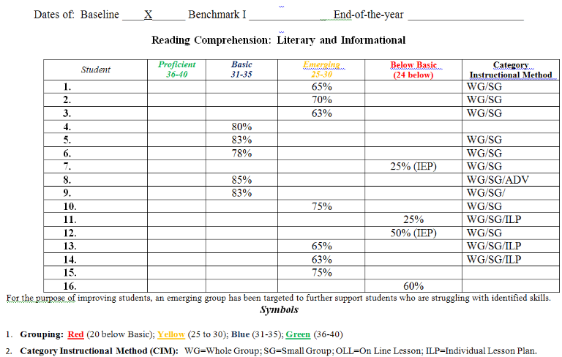
Grouping Students

Slide 18
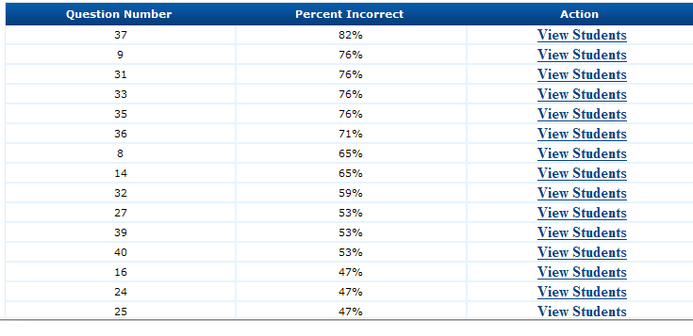
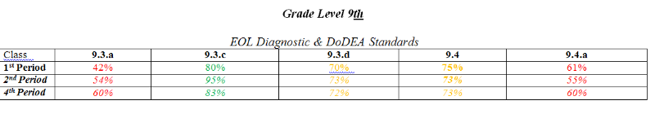
Most Frequently Missed
Notes:
Why is knowing the most frequently missed question important? How can sorting students to the question they missed an important grouping process for students and the teacher?

Slide 19
Closing
Review KWL
Before We Meet Again – Test talk with your class
Our next session
Segment 2: Planning to Implement Daily Data Driven Instruction
If you have questions about Segment 1 contact
Dr. Mayreather Willis @
mayreather.willis@clmatacademy.com

